Slide 1
Computer Vision

Slide 2
Main Branches
Classification
Segmentation
Object Detection

Slide 3
Classsification
Already covered
Show one in all classification notebook

Slide 4
Segmentation
Sementic Segmentation
Instance Segmentation
Popular Packages
Mask R CNN
Segment anywhere from META
> OPEN PDF File named Segmentation

Slide 5
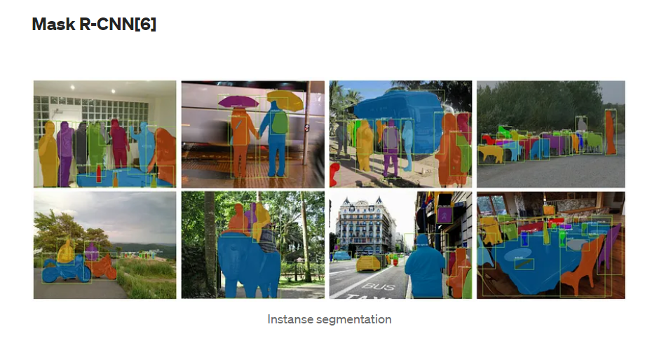

Slide 6
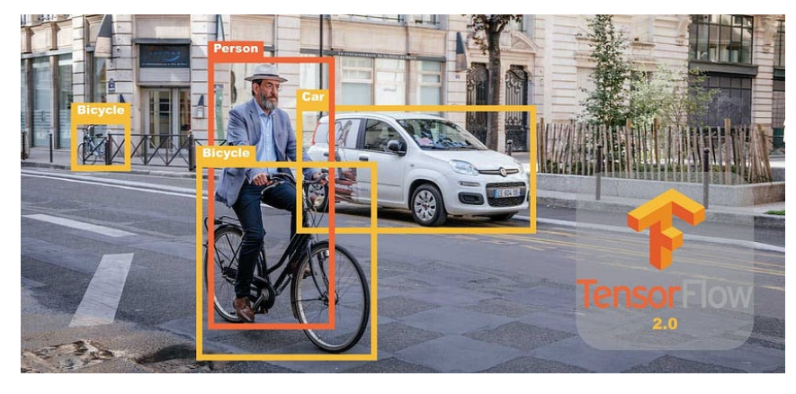
Object Detection
Detection and naming of the object in an image.
Concept of bounding boxes
concept of NMS (non maximum supperession)
Single Stage Detectors vs 2 stages detectors
Popular Packahes
OpenCV
Mediapipe
Yolo

Slide 7
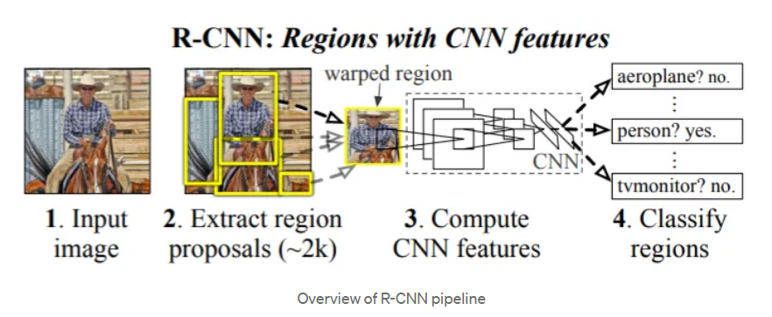
2-stage detection (R CNN)

Slide 8
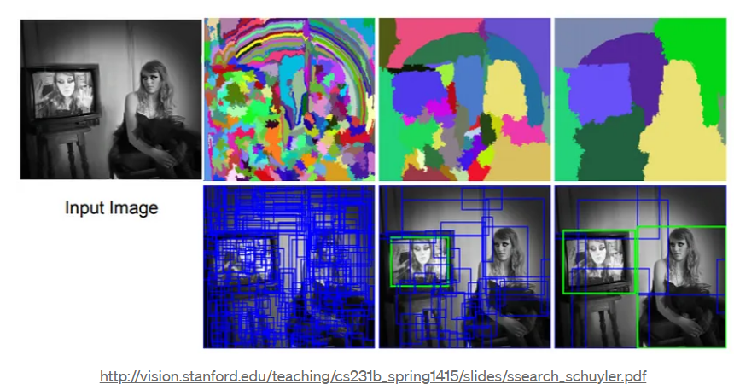
Process of object localization

Slide 9
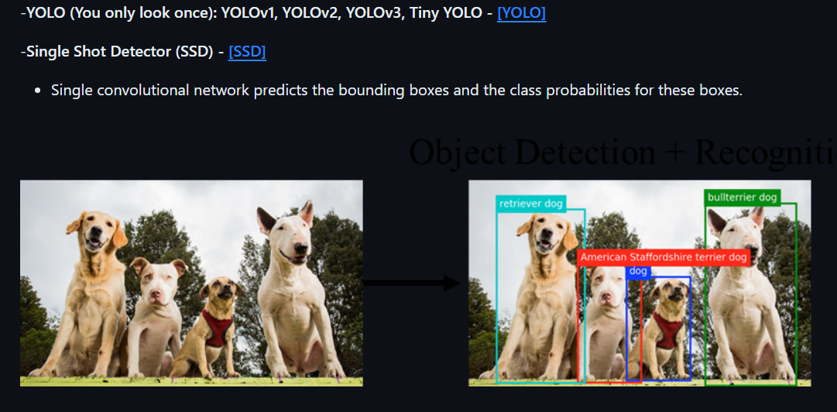
SSD (Yolo)

Slide 10
Concept of Vanishing Gradients
Discuss.

Slide 11
Residual Connections
Discuss

